Slide 1
I/O Basics

Slide 2
Why I/O not important in Java?
Most real applications of Java are not text-based, console programs. Rather, they are either graphically oriented programs that rely on one of Java’s graphical user interface (GUI) frameworks, such as Swing, the AWT, or JavaFX, for user interaction, or they are Web applications.
Although text-based, console programs are excellent as teaching examples, they do not constitute an important use for Java in the real world.
Also, Java’s support for console I/O is limited and somewhat awkward to use—even in simple example programs. Text-based console I/O is just not that useful in real-world Java programming.

Slide 3
Streams
Java programs perform I/O through streams.
A stream is an abstraction that either produces or consumes information.
A stream is linked to a physical device by the Java I/O system.
All streams behave in the same manner, even if the actual physical devices to which they are linked differ.
Thus, the same I/O classes and methods can be applied to different types of devices.

Slide 4
Streams
Streams are a clean way to deal with input/output without having every part of your code understand the difference between a keyboard and a network.
Java implements streams within class hierarchies defined in the java.io package.

Slide 5
Byte Streams and Character Streams
Java defines two types of streams: byte and character.
Byte streams provide a convenient means for handling input and output of bytes. Byte streams are used, for example, when reading or writing binary data.
Character streams provide a convenient means for handling input and output of characters. They use Unicode and, therefore, can be internationalized.
Also, in some cases, character streams are more efficient than byte streams
at the lowest level, all I/O is still byte-oriented. The character-based streams simply provide a convenient and efficient means for handling characters.

Slide 6
The Byte Stream Classes
Byte streams are defined by using two class hierarchies.
At the top are two abstract classes: InputStream and OutputStream.
Each of these abstract classes has several concrete subclasses that handle the differences among various devices, such as disk files, network connections, and even memory buffers.
The byte stream classes are in java.io

Slide 7
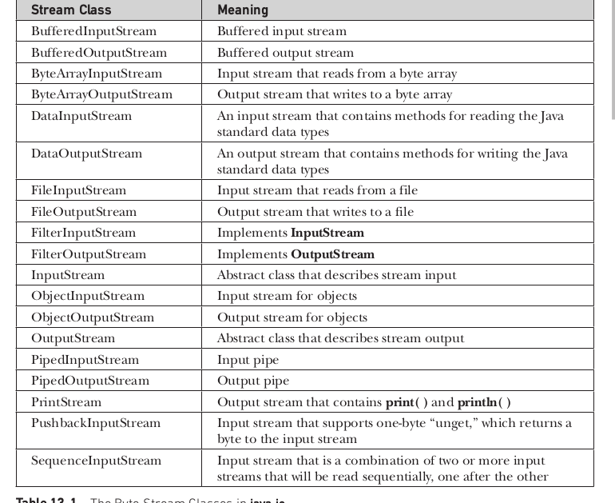
The Byte Stream Classes in java.io

Slide 8
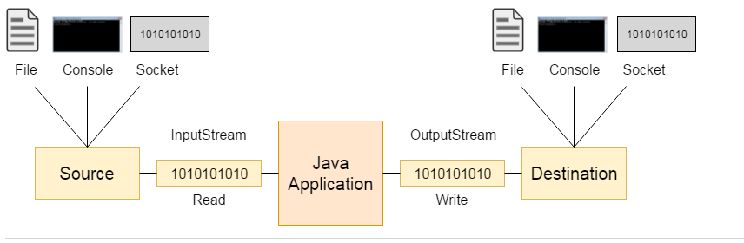

Slide 9
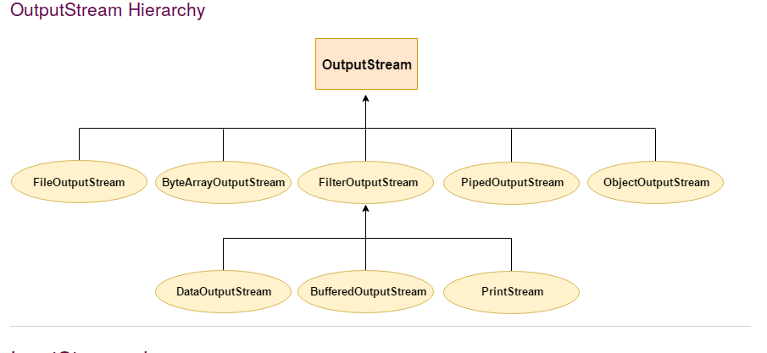

Slide 10
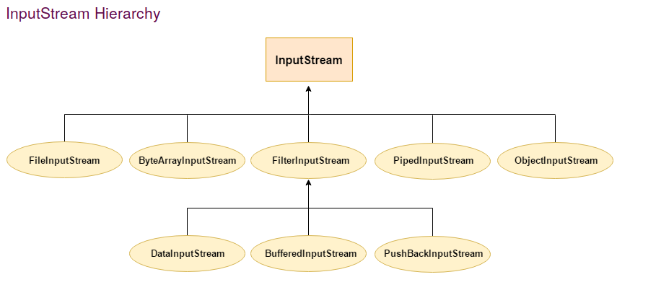

Slide 11
The Byte stream classes
The abstract classes InputStream and OutputStream define several key methods that the other stream classes implement.
Two of the most important are read( ) and write( ), which, respectively, read and write bytes of data.
Each has a form that is abstract and must be overridden by derived stream classes.

Slide 12
The Character Stream Classes
Character streams are defined by using two class hierarchies.
At the top are two abstract classes: Reader and Writer.
These abstract classes handle Unicode character streams. Java has several concrete subclasses of each of these.
The character stream classes are also in java.io

Slide 13
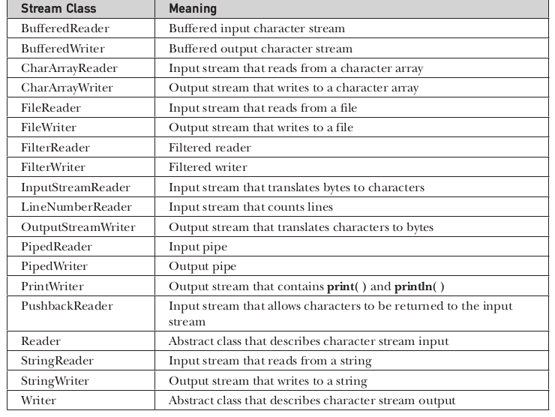
The Character Stream Classes in java.io

Slide 14
The Character Stream Classes
The abstract classes Reader and Writer define several key methods that the other stream classes implement.
Two of the most important methods are read( ) and write( ), which read and write characters of data, respectively.
Each has a form that is abstract and must be overridden by derived stream classes.

Slide 15
The Predefined Streams
All Java programs automatically import the java.lang package
This package defines a class called System, which encapsulates several aspects of the run-time environment.
For example, using some of its methods, you can obtain the current time and the settings of various properties associated with the system.
System also contains three predefined stream variables: in, out, and err.
These fields are declared as public, static, and final within System.

Slide 16
System class
System.out refers to the standard output stream. By default, this is the console.
System.in refers to standard input, which is the keyboard by default.
System.err refers to the standard error stream, which also is the console by default.
However, these streams may be redirected to any compatible I/O device.

Slide 17
System class
System.in is an object of type InputStream;
System.out and System.err are objects of type PrintStream.
These are byte streams, even though they are typically used to read and write characters from and to the console.

Slide 18
Reading Console Input
In Java 1.0, the only way to perform console input was to use a byte stream.
Today, using a byte stream to read console input is still acceptable. However, for commercial applications, the preferred method of reading console input is to use a character-oriented stream.
This makes your program easier to internationalize and maintain.

Slide 19
Reading Console Input
In Java, console input is accomplished by reading from System.in.
To obtain a character- based stream that is attached to the console, wrap System.in in a BufferedReader object.
BufferedReader supports a buffered input stream. A commonly used constructor is shown here:
  BufferedReader(Reader inputReader)

Slide 20
Reading Console Input
Here, inputReader is the stream that is linked to the instance of BufferedReader that is being created.
Reader is an abstract class. One of its concrete subclasses is InputStreamReader, which converts bytes to characters.
To obtain an InputStreamReader object that is linked to System.in, use the following constructor:
  InputStreamReader(InputStream inputStream)

Slide 21
Reading Console Input
Because System.in refers to an object of type InputStream, it can be used for inputStream.
Putting it all together, the following line of code creates a BufferedReader that is connected to the keyboard:
  BufferedReader br = new BufferedReader(new InputStreamReader(System.in));
After this statement executes, br is a character-based stream that is linked to the console through System.in.

Slide 22
Reading Characters
To read a character from a BufferedReader, use read( ). The version of read( ) that we will be using is
  int read( ) throws IOException
Each time that read( ) is called, it reads a character from the input stream and returns it as an integer value.
It returns –1 when the end of the stream is encountered. It can throw an IOException.

Slide 23
import java.io.*;
class BRRead {
public static void main(String args[]) throws IOException
{
char c;
BufferedReader br = new BufferedReader(new InputStreamReader(System.in));
System.out.println("Enter characters, 'q' to quit.");
do {
c = (char) br.read();
System.out.println(c);
} while(c != 'q');
}
}

Slide 24
OUTPUT:
Enter characters, 'q' to quit.
123abcq
1
2
3
a
b
c
q

Slide 25
Reading Strings
To read a string from the keyboard, use the version of readLine( ) that is a member of the BufferedReader class. Its general form is shown here:
  String readLine( ) throws IOException

Slide 26
import java.io.*;
class BRReadLines {
public static void main(String args[]) throws IOException
{
BufferedReader br = new BufferedReader(new InputStreamReader(System.in));
String str;
System.out.println("Enter lines of text.");
System.out.println("Enter 'stop' to quit.");
do {
str = br.readLine();
System.out.println(str);
} while(!str.equals("stop"));
}
}

Slide 27
// A tiny editor.
import java.io.*;
class TinyEdit {
public static void main(String args[]) throws IOException
{
BufferedReader br = new BufferedReader(new InputStreamReader(System.in));
String str[] = new String[100];
System.out.println("Enter lines of text.");
System.out.println("Enter 'stop' to quit.");
for(int i=0; i<100; i++) {
str[i] = br.readLine();
if(str[i].equals("stop")) break;
}

Slide 28
System.out.println("\nHere is your file:");
// display the lines
for(int i=0; i<100; i++) {
if(str[i].equals("stop")) break;
System.out.println(str[i]);
}
}
}

Slide 29
Enter lines of text.
Enter 'stop' to quit.
This is line one.
This is line two.
Java makes working with strings easy.
Just create String objects.
stop
Here is your file:
This is line one.
This is line two.
makes working with strings easy.
create String objects.

Slide 30
Writing Console Output
Console output is most easily accomplished with print( ) and println( )
These methods are defined by the class PrintStream
Even though System.out is a byte stream, using it for simple program output is still acceptable.

Slide 31
Writing Console Output
Because PrintStream is an output stream derived from OutputStream, it also implements the low-level method write( ).
Thus, write( ) can be used to write to the console.
The simplest form of write( ) defined by PrintStream is shown here:
  void write(int byteval)
This method writes the byte specified by byteval. Although byteval is declared as an integer, only the low-order eight bits are written

Slide 32
// Demonstrate System.out.write().
class WriteDemo {
public static void main(String args[]) {
int b;
b = 'A';
System.out.write(b);
System.out.write('\n');
}
}

Slide 33
The PrintWriter Class
For real-world programs, the recommended method of writing to the console when using Java is through a PrintWriter stream.
PrintWriter is one of the character-based classes.
Using a character-based class for console output makes internationalizing your program easier.
PrintWriter defines several constructors. The one we will use is shown here:
PrintWriter(OutputStream outputStream, boolean flushingOn)

Slide 34
Here, outputStream is an object of type OutputStream, and flushingOn controls whether Java flushes the output stream every time a println( ) method (among others) is called.
If flushingOn is true, flushing automatically takes place. If false, flushing is not automatic.
PrintWriter supports the print( ) and println( ) methods. Thus, you can use these methods in the same way as you used them with System.out.
If an argument is not a simple type, the PrintWriter methods call the object’s toString( ) method and then display the result.

Slide 35
// Demonstrate PrintWriter
import java.io.*;
public class PrintWriterDemo {
public static void main(String args[]) {
PrintWriter pw = new PrintWriter(System.out, true);
pw.println("This is a string");
int i = -7;
pw.println(i);
double d = 4.5e-7;
pw.println(d);
}
}

Slide 36
OUTPUT:
This is a string
-7
4.5E-7
There is nothing wrong with using System.out to write simple text output to the console when you are learning Java or debugging your programs.
However, using a PrintWriter makes your real-world applications easier to internationalize.

Slide 37
Reading and Writing Files
Java provides a number of classes and methods that allow you to read and write files.
Two of the most often-used stream classes are FileInputStream and FileOutputStream, which create byte streams linked to files.
To open a file, you simply create an object of one of these classes, specifying the name of the file as an argument to the constructor.

Slide 38
Reading and Writing files
FileInputStream(String fileName) throws FileNotFoundException
FileOutputStream(String fileName) throws FileNotFoundException
Here, fileName specifies the name of the file that you want to open. When you create an input stream, if the file does not exist, then FileNotFoundException is thrown.
For output streams, if the file cannot be opened or created, then FileNotFoundException is thrown.
FileNotFoundException is a subclass of IOException. When an output file is opened, any preexisting file by the same name is destroyed.

Slide 39
When you are done with a file, you must close it.
This is done by calling the close( ) method, which is implemented by both FileInputStream and FileOutputStream.
void close( ) throws IOException
Closing a file releases the system resources allocated to the file, allowing them to be used by another file.
Failure to close a file can result in “memory leaks” because of unused resources remaining allocated.
NOTE Beginning with JDK 7, the close( ) method is specified by the AutoCloseable interface in java.lang. AutoCloseable is inherited by the Closeable interface in java.io. Both interfaces are implemented by the stream classes, including FileInputStream and FileOutputStream.

Slide 40
Read from file
To read from a file, you can use a version of read( ) that is defined within FileInputStream.
The one that we will use is shown here:
int read( ) throws IOException
Each time that it is called, it reads a single byte from the file and returns the byte as an integer value.
read( ) returns –1 when the end of the file is encountered.
It can throw an IOException.

Slide 41
import java.io.*;
class ShowFile {
public static void main(String args[])
{
int i;
FileInputStream fin;
// First, confirm that a filename has been specified.
if(args.length != 1) {
System.out.println("Usage: ShowFile filename");
return;
}

Slide 42
// Attempt to open the file.
try {
fin = new FileInputStream(args[0]);
} catch(FileNotFoundException e) {
System.out.println("Cannot Open File");
return;
}
try {
do {
i = fin.read();
if(i != -1) System.out.print((char) i);
} while(i != -1);
} catch(IOException e) {
System.out.println("Error Reading File");
}

Slide 43
// Close the file.
try {
fin.close();
} catch(IOException e) {
System.out.println("Error Closing File");
}
}
}

Slide 44
The variation of the previous program is to call close( ) within a finally block.
In this approach, all of the methods that access the file are contained within a try block, and the finally block is used to close the file.
This way, no matter how the try block terminates, the file is closed.

Slide 45
try {
do {
i = fin.read();
if(i != -1) System.out.print((char) i);
} while(i != -1);
} catch(IOException e) {
System.out.println("Error Reading File");
} finally {
// Close file on the way out of the try block.
try {
fin.close();
} catch(IOException e) {
System.out.println("Error Closing File");
}
}

Slide 46
Sometimes it’s easier to wrap the portions of a program that open the file and access the file within a single try block (rather than separating the two) and then use a finally block to close the file.
import java.io.*;
class ShowFile {
public static void main(String args[])
{
int i;
FileInputStream fin = null;
if(args.length != 1) {
System.out.println("Usage: ShowFile filename");
return;
}

Slide 47
try {
fin = new FileInputStream(args[0]);
do {
i = fin.read();
if(i != -1) System.out.print((char) i);
} while(i != -1);
} catch(FileNotFoundException e) {
System.out.println("File Not Found.");
} catch(IOException e) {
System.out.println("An I/O Error Occurred");
} finally {
try {
if(fin != null) fin.close();
} catch(IOException e) {
System.out.println("Error Closing File");
} } } }

Slide 48
In this approach, notice that fin is initialized to null. Then, in the finally block, the file is closed only if fin is not null.
This works because fin will be non-null only if the file is successfully opened. Thus, close( ) is not called if an exception occurs while opening the file.

Slide 49
Write into file
To write to a file, you can use the write( ) method defined by FileOutputStream.
Its simplest form is shown here:
  void write(int byteval) throws IOException
This method writes the byte specified by byteval to the file.
Although byteval is declared as an integer, only the low-order eight bits are written to the file. If an error occurs during writing, an IOException is thrown.

Slide 50
import java.io.*;
class CopyFile {
public static void main(String args[]) throws IOException
{
int i;
FileInputStream fin = null;
FileOutputStream fout = null;
// First, confirm that both files have been specified.
if(args.length != 2) {
System.out.println("Usage: CopyFile from to");
Return;
}

Slide 51
try {
// Attempt to open the files.
fin = new FileInputStream(args[0]);
fout = new FileOutputStream(args[1]);
do {
i = fin.read();
if(i != -1) fout.write(i);
} while(i != -1);
} catch(IOException e) {
System.out.println("I/O Error: " + e);
}

Slide 52
finally {
try {
if(fin != null) fin.close();
} catch(IOException e2) {
System.out.println("Error Closing Input File");
}
try {
if(fout != null) fout.close();
} catch(IOException e2) {
System.out.println("Error Closing Output File");
}
}
}
}

Slide 53
In the program, notice that two separate try blocks are used when closing the files.
This ensures that both files are closed, even if the call to fin.close( ) throws an exception.

Slide 54
Automatically Closing a File
JDK 7 added a new feature that offers another way to manage resources, such as file streams, by automating the closing process.
This feature, sometimes referred to as automatic resource management, or ARM for short, is based on an expanded version of the try statement.
The principal advantage of automatic resource management is that it prevents situations in which a file (or other resource) is inadvertently not released after it is no longer needed.

Slide 55
Automatically closing a file
Automatic resource management is based on an expanded form of the try statement.
Here is its general form:
try (resource-specification) {
// use the resource
}
Here, resource-specification is a statement that declares and initializes a resource, such as a file stream.
It consists of a variable declaration in which the variable is initialized with a reference to the object being managed.
When the try block ends, the resource is automatically released.

Slide 56
In the case of a file, this means that the file is automatically closed. (Thus, there is no need to call close( ) explicitly.)
This new form of try is called the try-with-resources statement.
The try-with-resources statement can be used only with those resources that implement the AutoCloseable interface defined by java.lang. This interface defines the close( ) method. AutoCloseable is inherited by the Closeable interface in java.io.
Both interfaces are implemented by the stream classes.
Thus, try-with-resources can be used when working with streams, including file streams.

Slide 57
import java.io.*;
class ShowFile {
public static void main(String args[])
{
int i;
// First, confirm that a filename has been specified.
if(args.length != 1) {
System.out.println("Usage: ShowFile filename");
return;
}

Slide 58
try(FileInputStream fin = new FileInputStream(args[0])) {
do {
i = fin.read();
if(i != -1) System.out.print((char) i);
} while(i != -1);
} catch(FileNotFoundException e) {
System.out.println("File Not Found.");
} catch(IOException e) {
System.out.println("An I/O Error Occurred");
} } }

Slide 59
The variable fin is local to the try block, being created when the try is entered.
When the try is left, the stream associated with fin is automatically closed by an implicit call to close( ). You don’t need to call close( ) explicitly
It is important to understand that the resource declared in the try statement is implicitly final.
This means that you can’t assign to the resource after it has been created. Also, the scope of the resource is limited to the try-with-resources statement.

Slide 60
You can manage more than one resource within a single try statement.
To do so, simply separate each resource specification with a semicolon.
import java.io.*;
class CopyFile {
public static void main(String args[]) throws IOException
{
int i;
// First, confirm that both files have been specified.
if(args.length != 2) {
System.out.println("Usage: CopyFile from to");
return;
}

Slide 61
try (FileInputStream fin = new FileInputStream(args[0]);
FileOutputStream fout = new FileOutputStream(args[1]))
{
do {
i = fin.read();
if(i != -1) fout.write(i);
} while(i != -1);
} catch(IOException e) {
System.out.println("I/O Error: " + e);
} } }

